Slide 1
S&P 500 Dashboard
File created on: 10/27/25 6:49:16 PM MST

Slide 5
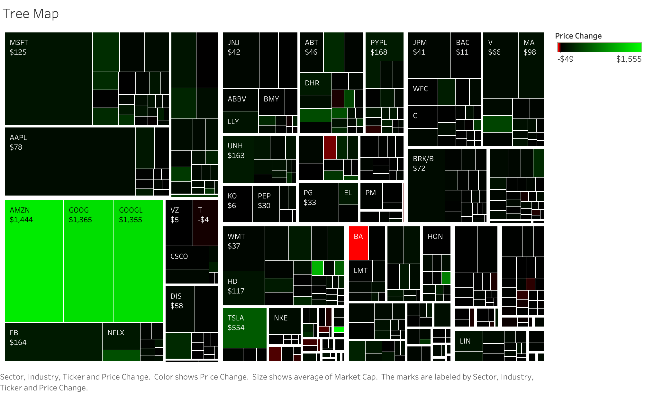

Slide 6
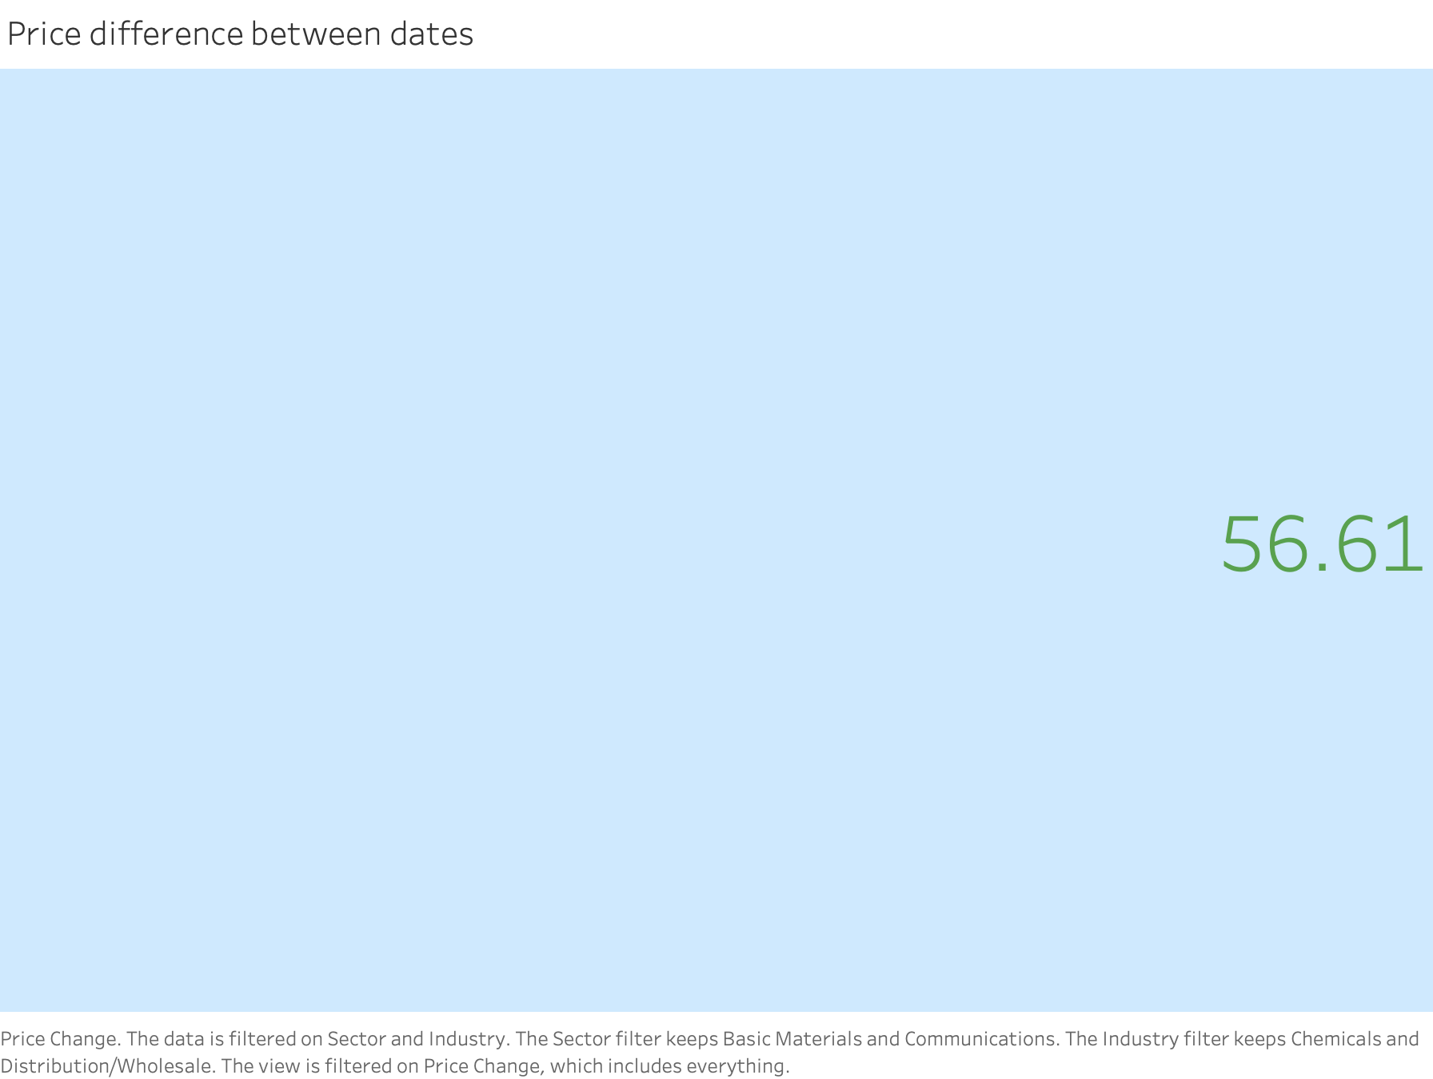

Slide 7
